Slide 1


Proyek
Akhir SBD
QueueEase
Kelompok C3

Slide 2
QueueEase
What is ??
The "QueueEase" project is an implementation of a queue system in a bank aimed at simplifying the customer service process. The system consists of four main components: Teller, FrontDesk, Admin, and Monitor. QueueEase offers a range of features and benefits, making it the ideal solution for streamlining customer service operations.
Real-time and Fast Updates
Mobile Accessibility
Voice Features
QueueEase is built on the Node.js framework, leveraging its scalability and efficiency. The system utilizes a database to store and manage the necessary data, ensuring reliability and seamless operation.

Slide 3
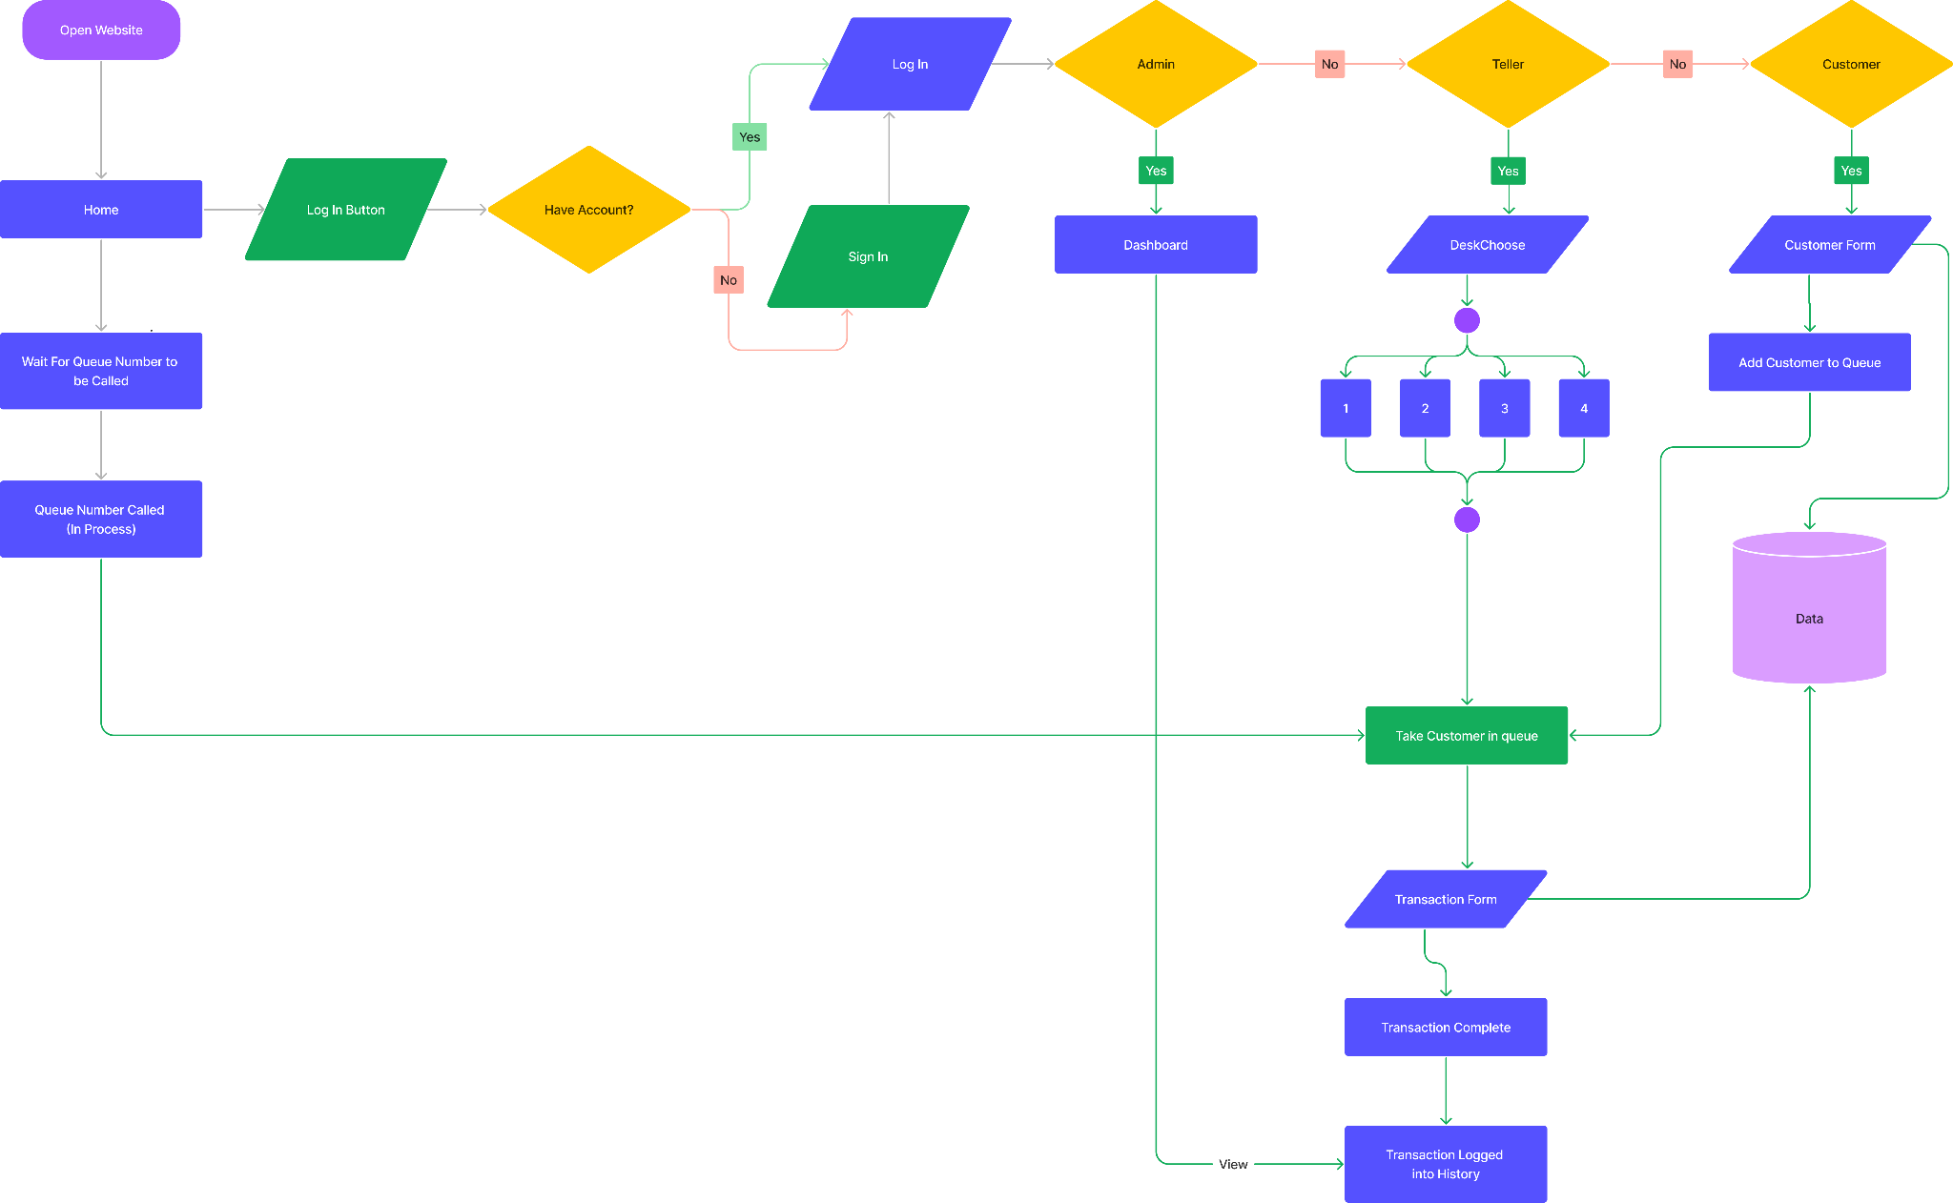
Flowchart

Slide 4
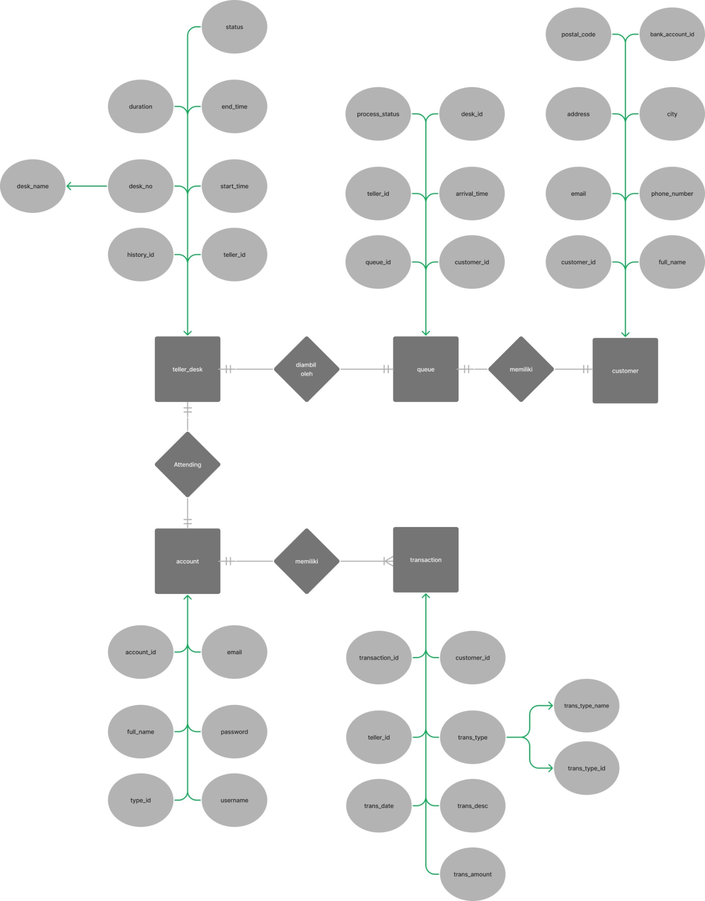
Entity-Relationship Diagram

Slide 5
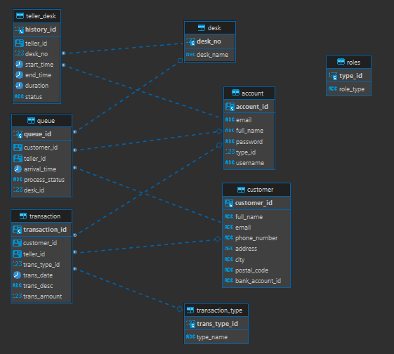
Unified Modeling Language (UML)

Slide 6
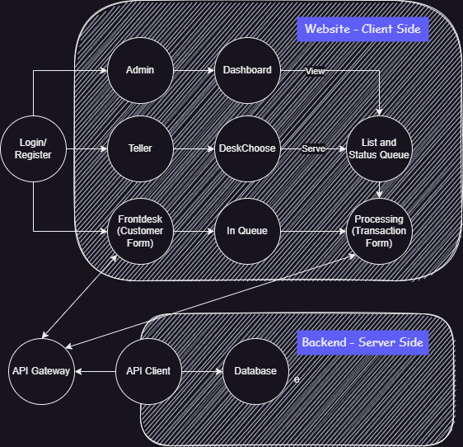
Skenario Database dan Website

Slide 7

Thanks!

